Slide 1
Microsoft O365 and NHS
Ben Lopez
ben-lopez@phoenixs.co.uk
07789688298

Slide 2
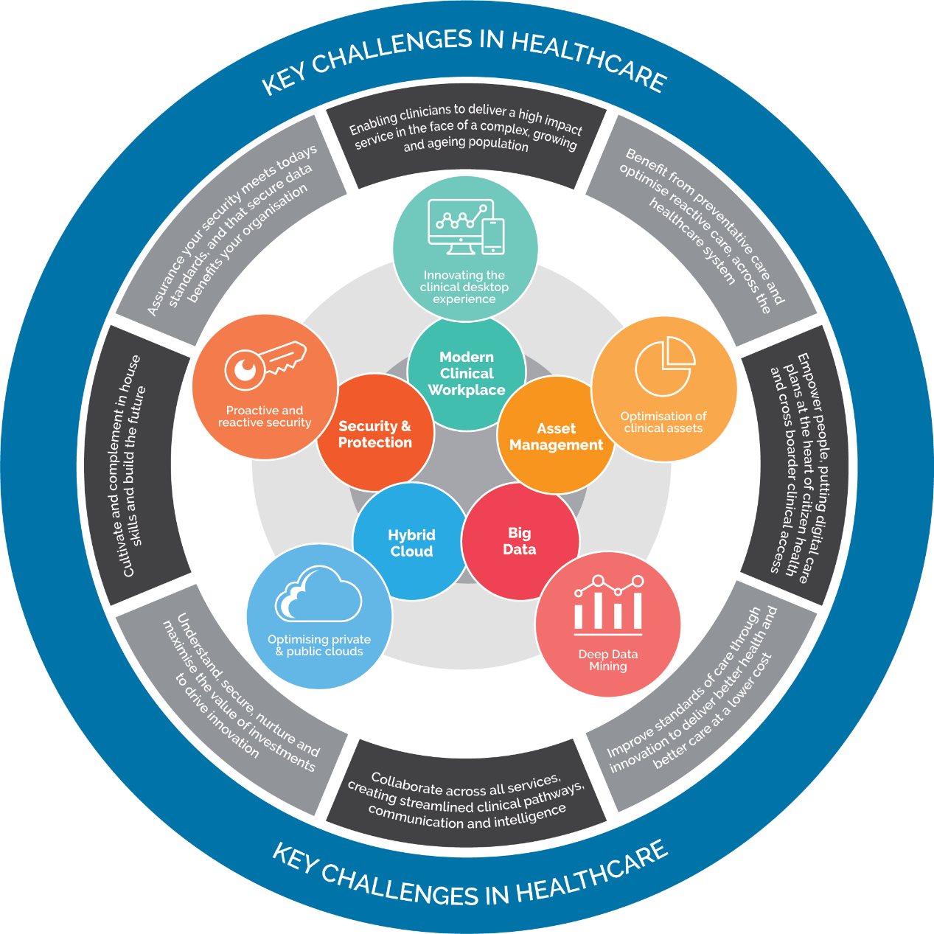

Slide 3
CUSTOMERS

Slide 4
Health Cloud Solutions
Modern Workplace + Security
Microsoft Azure
Managed Service
Advanced Workloads
O/M365 Projects
Windows 10 Migration
Security Solutions
Change Management & End User Adoption
Surface Device Attach
Datacentre Transformation
Migration to Azure
Cloud Economics (SAM)
Cloud Platform Management
SQL and Windows Server EOS
Windows 10 Secure Managed Desktop
BCDR Managed Service
Azure & O365 MSP
Data and BI
IoT
Speech & Vision
Chatbots
Augmented Reality
Adv Cloud Workloads

Slide 5
PHOENIX SOFTWARE
NHS ENGAGEMENT PLAN
Phase 1
Phase 2
Phase 3
Phase 4
M365
DEPLOYMENT
PROJECTS
Identity
& Exchange
Exchange Migration
O365 Collaboration Teams, SharePoint Online, OneDrive, Planner, PowerApps
Flow, Planner, Delve, Stream + Third party Vendors
Collaboration Planning
Ongoing Support?
CYBER SECURITY
Discovery
Threats and Vulnerabilities
CareCerts?
WINDOWS 10
Discovery & Alignment
Functional Readiness
Technical Rollout & Management
USER ADOPTION
CHANGE MANAGEMENT
Microsoft CIE
User Adoption, Training & Communications
Microsoft CIE
User Adoption, Training & Communications
LICENSING MILESTONES
Licensing Workshop
Software Optimisation Service
Microsoft Licensing Agreement
Review Online Services
Consumption
Ongoing Licensing Reviews

Slide 6
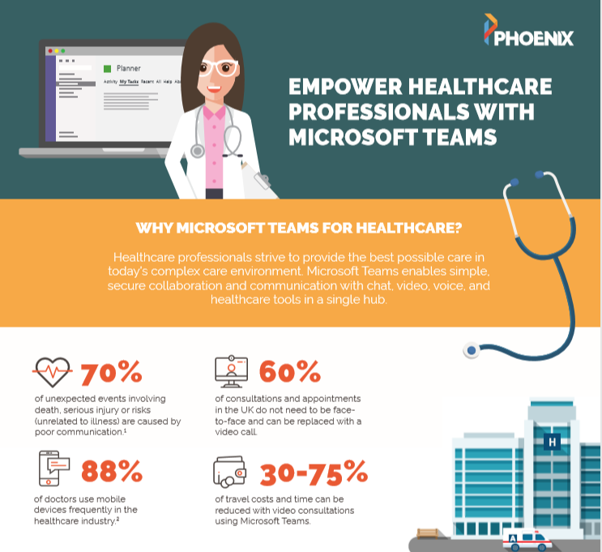

Slide 7
